Slide 1


Slide 2








Slide 3


-
-

Slide 4














Slide 5





-
-
-

Slide 6


static void checkRelationship(Instant otherInstant) {
Instant nowInstant = Instant.now();
if(otherInstant.compareTo(nowInstant) > 0) System.out.println("Instant is in the future");
else if(otherInstant.compareTo(nowInstant) < 0) System.out.println("Instant is in the past");
else
System.out.println("Instant is now");
}

Slide 7





















Slide 8




-
-
-
-
-

Slide 9




-
-
-
-

Slide 10



-
-
-
-
-

Slide 11


LocalDate today = LocalDate.now();
System.out.println(today);
2022-03-01
DateTimeFormatter usDateFormat =
DateTimeFormatter.ofPattern("MM-dd-yyyy"); System.out.println(today.format(usDateFormat));
03-01-2022

Slide 12

String usDateString = "07-04-2022";
LocalDate failedDate = LocalDate.parse(usDateString); // ERROR!!
DateTimeFormatter usDateFormat = DateTimeFormatter.ofPattern("MM-dd-yyyy");
LocalDate theDate = LocalDate.parse(usDateString, usDateFormat);

Slide 13







-
-
-
-
-

Slide 14






-
-
-
-
-
-
-

Slide 15

-
-
-
-

Slide 16
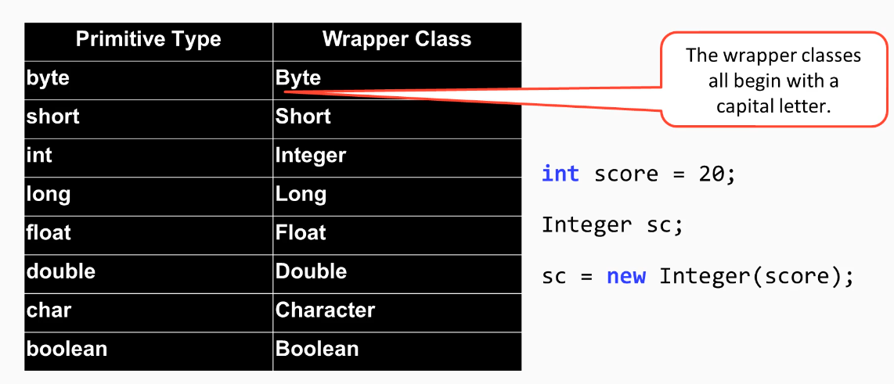

Slide 17
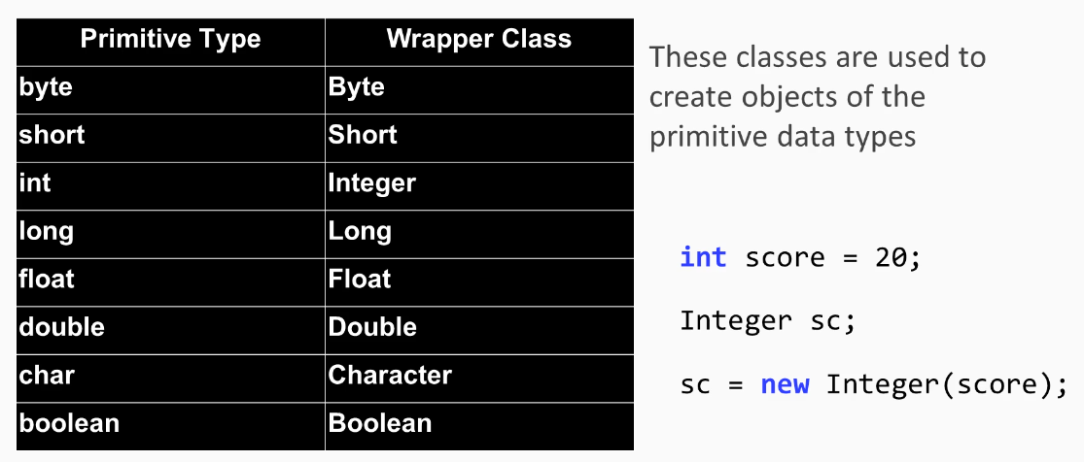

Slide 18
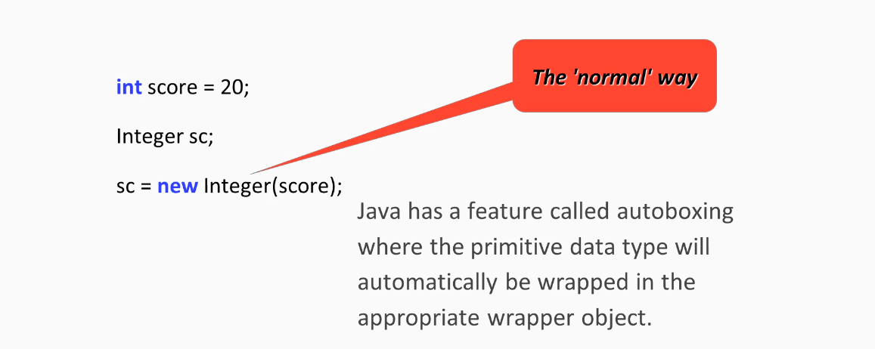

Slide 19



-
-
-
-
-
-

Slide 20





-
-
-
-
-
-
-

Slide 21
-
-
-

